Slide 1
Developing presentation in a social media environment
Instructor: Khalida Hameed

Slide 2
Planning a presentation
Business presentations involve all of your communication skills including research, planning, writing, visual design, and interpersonal and non-verbal communication.
They demonstrate your ability to think on your feet, grasp complex business issues, and handle challenging situations.
Nervousness before a presentation is natural and a good thing. It shows your concern as a speaker/presenter.
Planning presentations is like planning any other business writing: you analyze the situation, gather information, select the right medium, and organize the information. Nancy Duarte’s rule of thumb: for a 1-hour presentation that uses thirty slides, allow 36 to 90 hours to research, conceive, create, and practice.

Slide 3
Analyzing the situation
Analyzing the situation involves defining your purpose and developing an audience profile.
Purpose: The purpose of most presentations will be to inform or to persuade, although you may occasionally need to make a collaborative presentation.
Developing an audience profile:
Try to anticipate the likely emotional state of your audience members.
You also need to determine whether your audience is comfortable listening to the language you speak. (speak slowly and distinctly, repeat key words and phrases, aim for clarity, communication with body language)
Also consider the circumstances in which you will be making your presentation.
For in person presentations pay close attention to seating arrangements (classroom or theatre sitting, conference table seating, horseshoe or U-shaped seating, café seating)

Slide 4
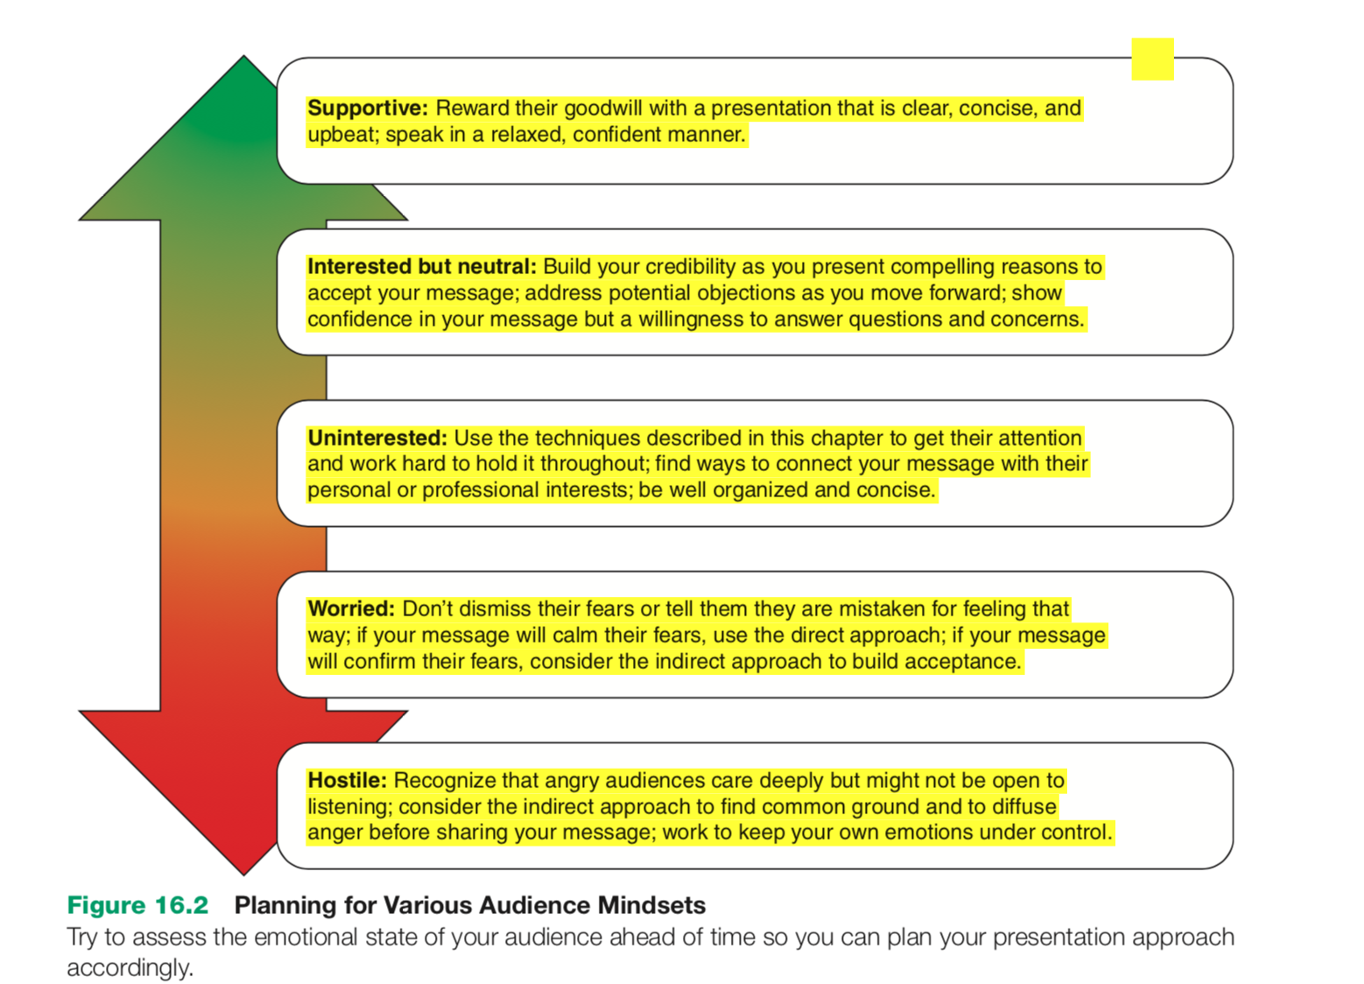

Slide 5
Organizing a presentation
The possibilities for organizing a business presentation fall into two basic categories: linear or nonlinear.
Linear presentations: they are like printed documents that follow a fixed path from start to finish. The linear model is appropriate for speeches, technical and financial presentations, and other presentations in which you want to convey your message point by point or build up to a conclusion following logical steps.
Nonlinear presentation: they give the presenter the option to move back and forth between topics and and up and down in terms of level of detail. These presentations can be useful when you want to be able to show complicated relationships between the “big picture” and specific details, to explore complex visuals, or to have the flexibility to move from topic to topic in any order.

Slide 6
Presentation software
Microsoft PowerPoint, Apple Keynote, Google Slides, and similar packages use sequences of individual slides, often referred to as a slide deck. They don’t necessarily need to be presented in a strict linear order, because the presenter does have the option of jumping out of the predefined order, but in most presentations using slides, the speaker moves from start to finish in that order.
Prezi is the best-known nonlinear presentation software and doesn’t use the concept of individual slides. Instead, you start from a min screen, or canvas, which often presents the big picture overview of your topic.

Slide 7
Points to remember
Match the tool to the task and not the other way round. For example, a detailed technical discussion might need a linear presentation, whereas a free-form brainstorming session might benefit from a nonlinear approach.
If they are used well, software features can help you tell your story, but your story is what matters – not the software.
In spite of their reputation, PowerPoint and other conventional slide programs aren’t limited to creating boring, linear flow of bullet points.

Slide 8
Defining your main idea
A successful presentation starts with a clear picture of the main idea you want to share with your audience.
Start by composing a one-sentence summary that links your subject and purpose to your audience’s frame of reference. Example: Convince management that reorganizing the technical support will improve customer service and reduce employee turnover.

Slide 9
Limiting your scope
Limiting your scope is important for two reasons: to ensure that your presentation fits the allotted time and to make sure you respect your audience members’ time and attention.
The only sure way to measure the length of your presentation is to complete a practice run.
Limitations can force you to focus on the most essential message points that are important to your audience.
In case of time limit, consider a hybrid approach in which you present your key points in summary form and give people handouts with additional details.

